Slide 1

UNIT II MASTERING COMMUNICATION SKILLS
Slide 1.

Slide 2
Communication, at its simplest, is the act of transferring information from one place to another. It may be vocally (using voice), written (using printed or digital media such as books, magazines, websites or emails), visually (using logos, maps, charts or graphs) or non-verbally (using body language, gestures and the tone and pitch of voice).
Slide 2.

Slide 3
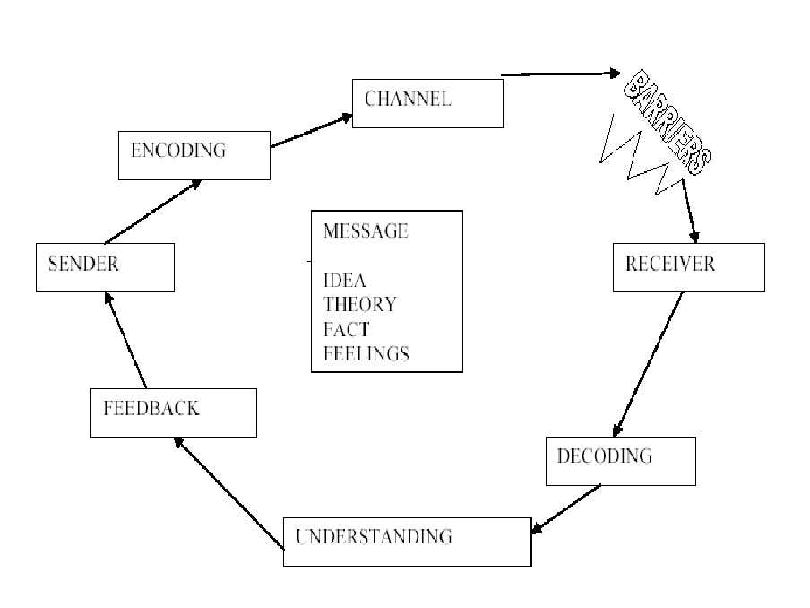
Slide 3.

Slide 4
Poll 1. Which of these is the external sounds present in the channels of communication? a) Noise b) Semantic problems c) Cultural barriers d) Over communication
Slide 4.

Slide 5
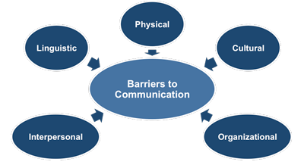
Slide 5.

Slide 6
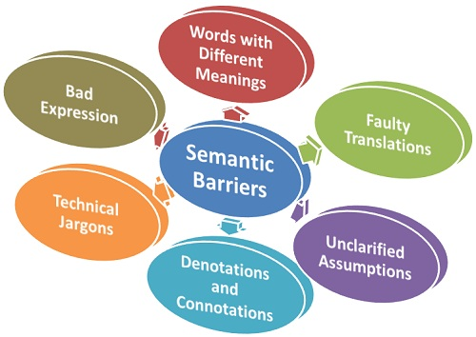
1.
Slide 6.

Slide 7
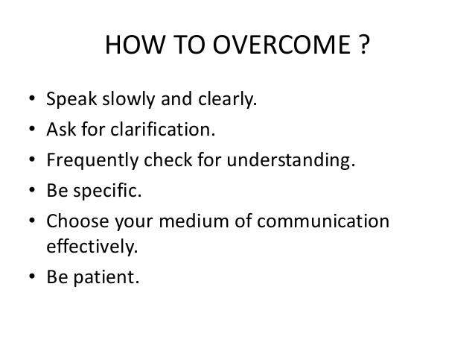
Slide 7.

Slide 8
Poll 2. Which of these occur because of difference in language? a) Physical barriers b) Linguistic barriers c) Cultural barriers d) Speech decoding
Slide 8.

Slide 9
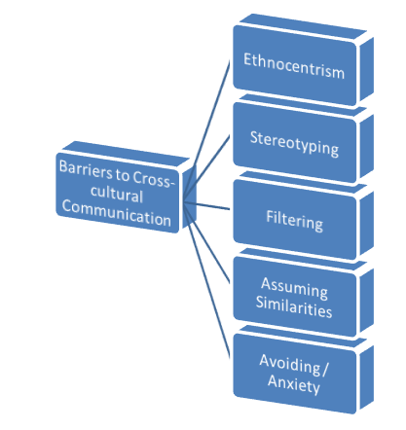
2.
Slide 9.

Slide 10
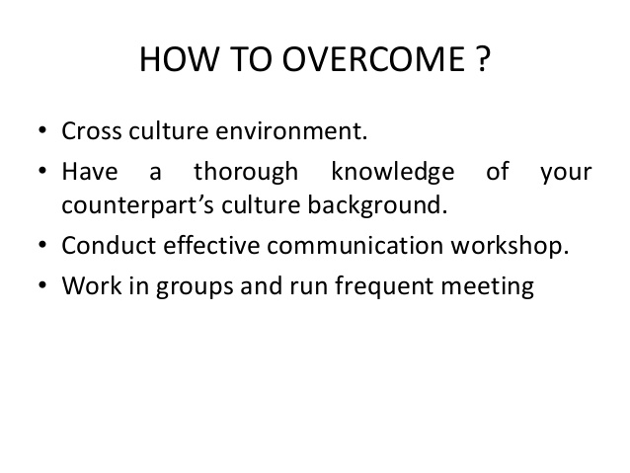
Slide 10.

Slide 11
Poll 3. Which of these barriers occur when people belong to different religious backgrounds? a) Physical barriers b) Linguistic barriers c) Cultural barriers d) Speech decoding
Slide 11.

Slide 12
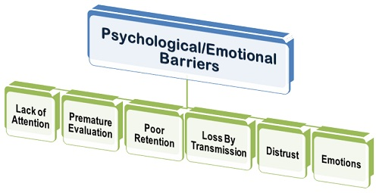
3.
Slide 12.

Slide 13
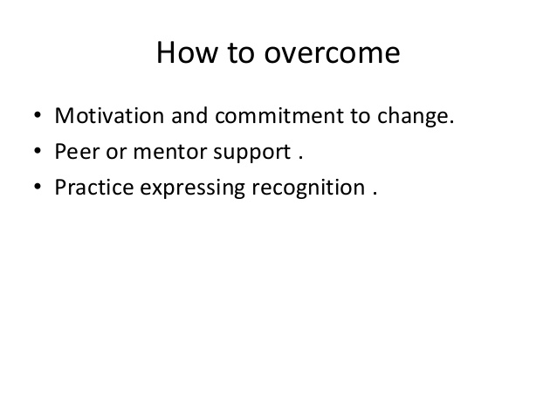
Slide 13.

Slide 14
Poll 4. Which of these must be avoided for effective communication? a) Sharing of activity b) Listening c) Ambiguity d) Politeness
Slide 14.

Slide 15
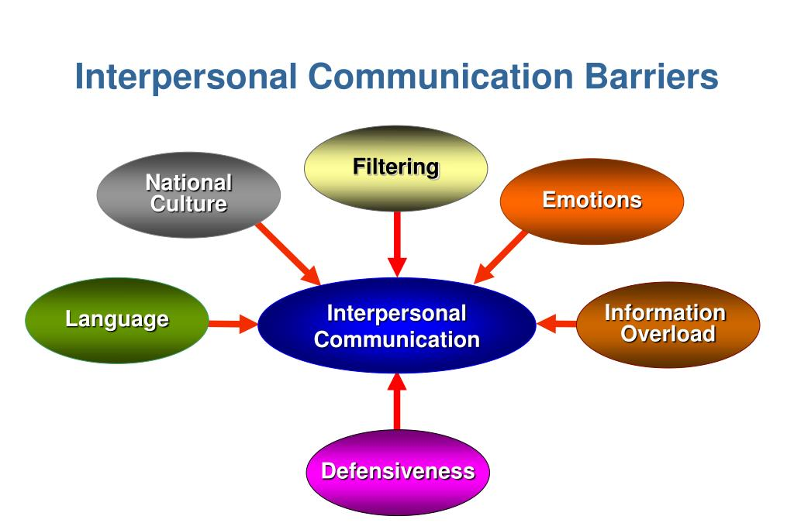
4.
Slide 15.

Slide 16
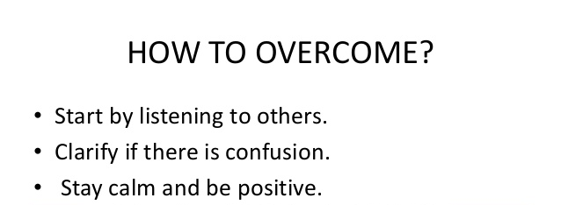
Slide 16.

Slide 17
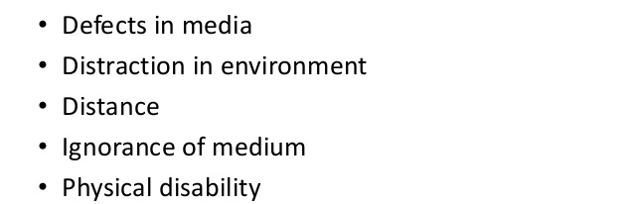
5.
Physical Barrier
Slide 17.

Slide 18
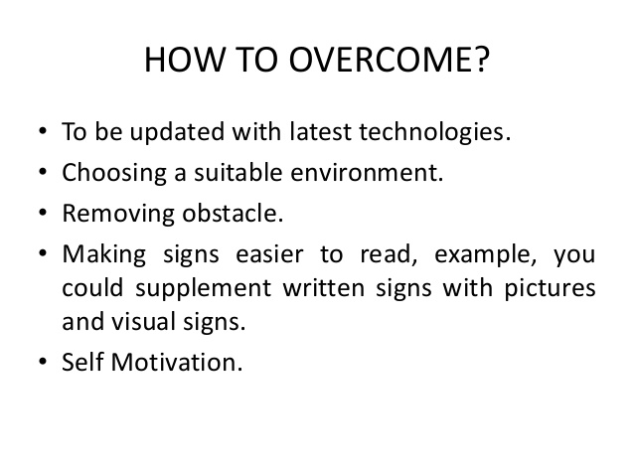
Slide 18.

Slide 19
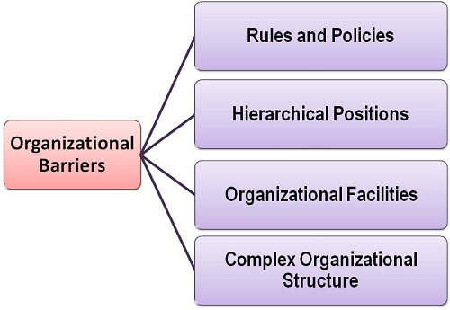
6.
Slide 19.

Slide 20
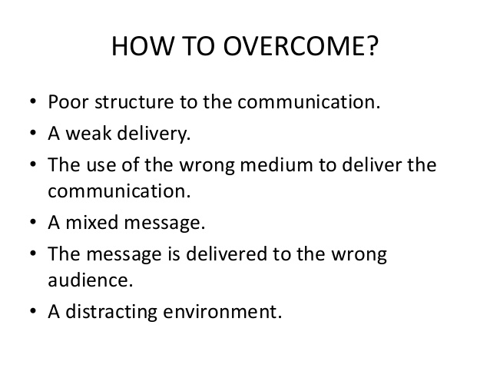
Slide 20.

Slide 21
Poll 5. Communication should serve as a conflict- reduction exercise. a) True b) False
Slide 21.

Slide 22
Importance of Communication
1. The Basis of Co-ordination
2. Fluent Working
3. The Basis of Decision Making
4. Increases Managerial Efficiency
5. Increases Cooperation and Organizational Peace
6. Boosts Morale of the Employees
Slide 22.

Slide 23
Poll 6. To be a good communicator, one does not need to speak but spectate others speaking.
YES
No
Slide 23.

Slide 24
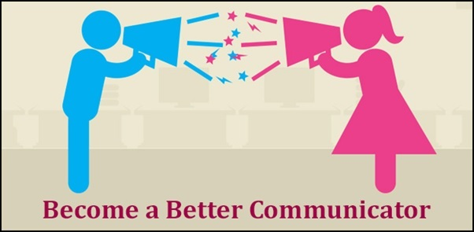
Law of paying the price.
Visual mental rehearsal
Identify dominant learning style
Spectators don’t learn much, players do.
Fire your mental faculties with L/S/R/W/W
Don’t fake
Raise the hand when it comes to speaking.
Believe
Review
Follow good role model: how a person is influencing the crowd.
Experiment.
Slide 24.

Slide 25
Thank you.

